Slide 1
Generative AI. Course Intro
Andrey Kuznetsov
PhD, Head of FusionBrain Lab, AIRI
Term 5. Modern Methods and Algorithms of Generative Artificial Intelligence

Slide 2
Intro
00

Slide 3

About me
2010 — graduated from Samara State Aerospace University (currently, Samara National Research University)
2013 — defended the Candidate of Science thesis «Remote sensing data tampering detection method»
Took team lead and principal research roles on RFBR and RSCI grants
Worked in the Samsung laboratory based at the POMI RAS, St. Petersburg, implemented Upwork projects on the topic of computer vision, etc.
Since 2021 — involved in multimodal generative AI world
One of the creators of the Kandinsky model family
Since 2022, I have been working at Sber AI
Since 2023, I have been working at AIRI
I am a member of the program committees of leading scientific and scientific-practical conferences in Russia: Practical ML, YaTalks, AiConf, etc.
I regularly give lectures at conferences and podcasts
More than 100 peer-reviewed publications, including articles in Q1 and Core A/A* conferences proceedings, h-index=12

Slide 4




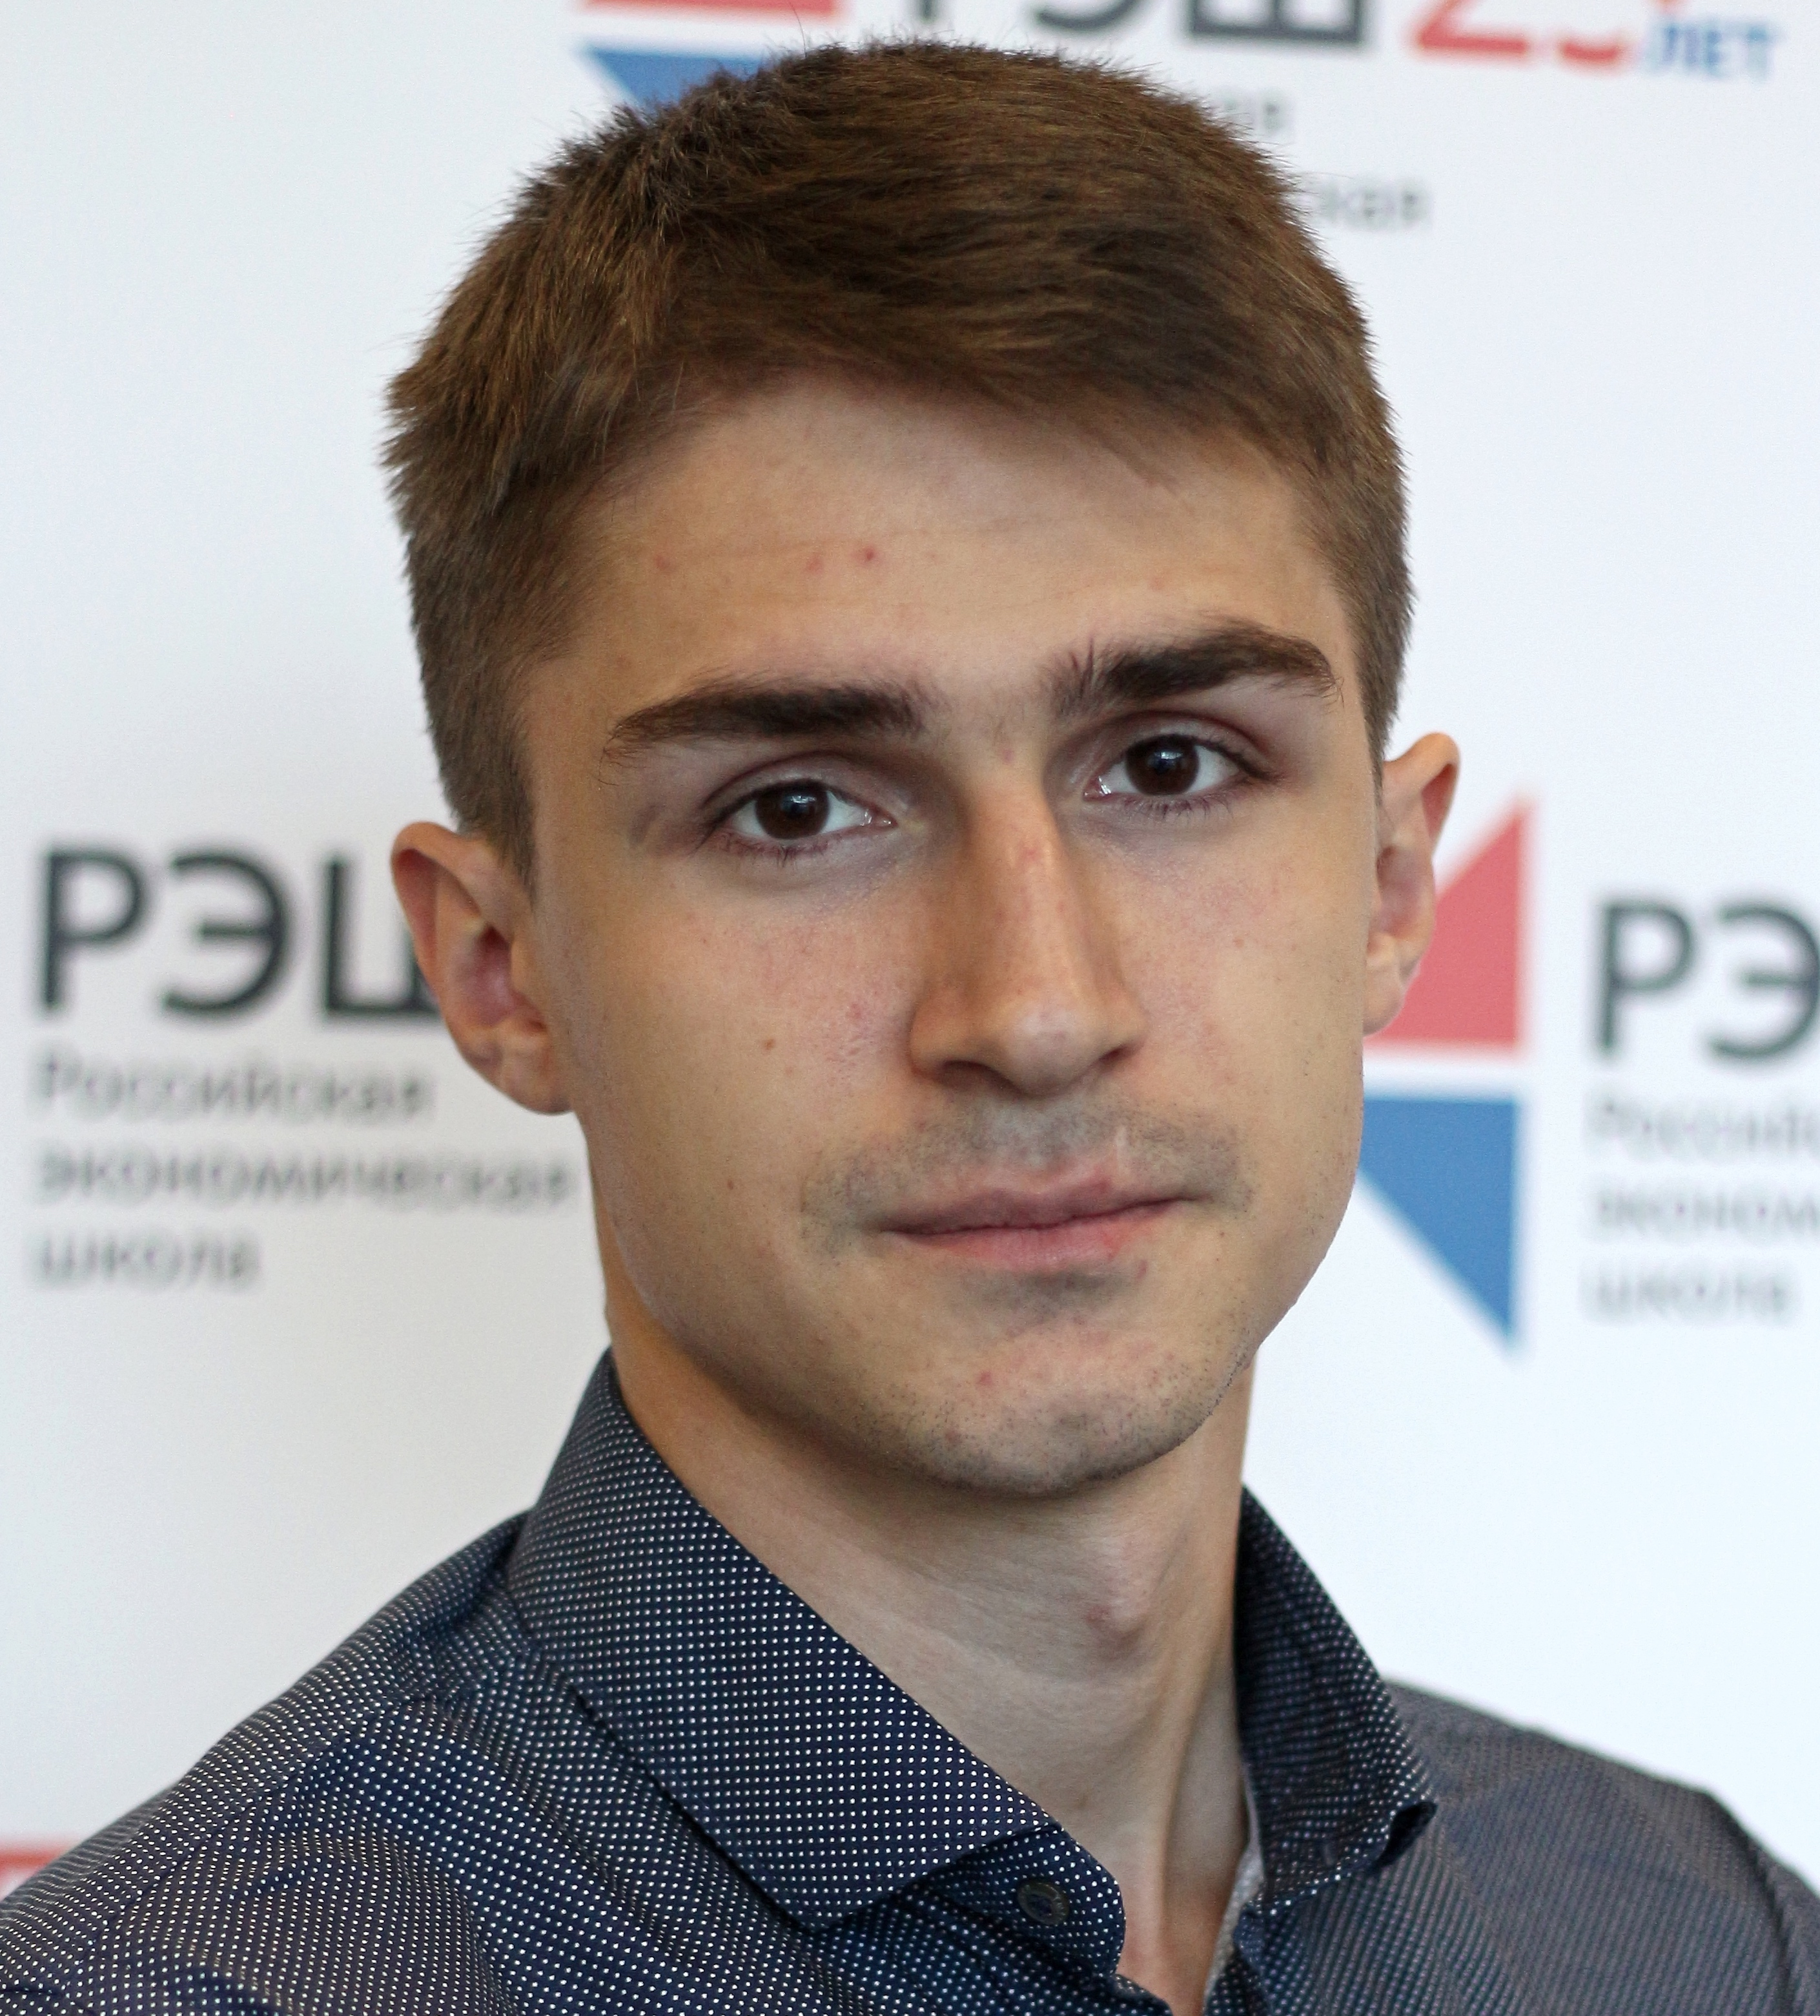

FusionBrain Laboratory
FusionBrain
Architectural insights
Multimodal & Multiagent
Robotics
Generative AI

Slide 5
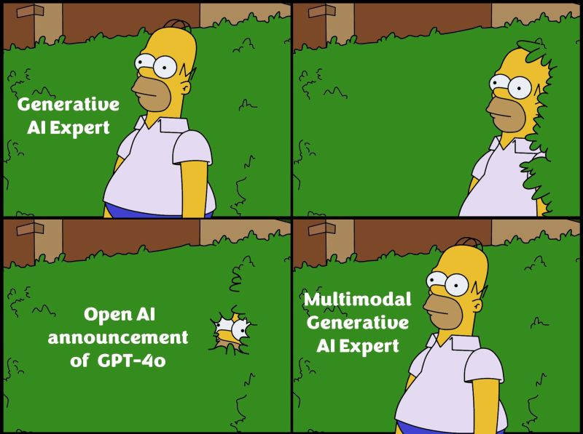
Course plan
Two months (Sep and Oct)
10 topics to cover
1. Generative AI. Course Intro
2. Large language models and applications
3. Foundation models
4. Multimodality. Perception. Part I
5. Multimodality. Perception. Part II
6. Long context analysis
7. Domain-specific applications
8. Multimedia content generation
9. Diffusion-based models
10. Multimodal agents
Invited lectures by FusionBrain Lab team leads
Lectures and seminars
Project work

Slide 6
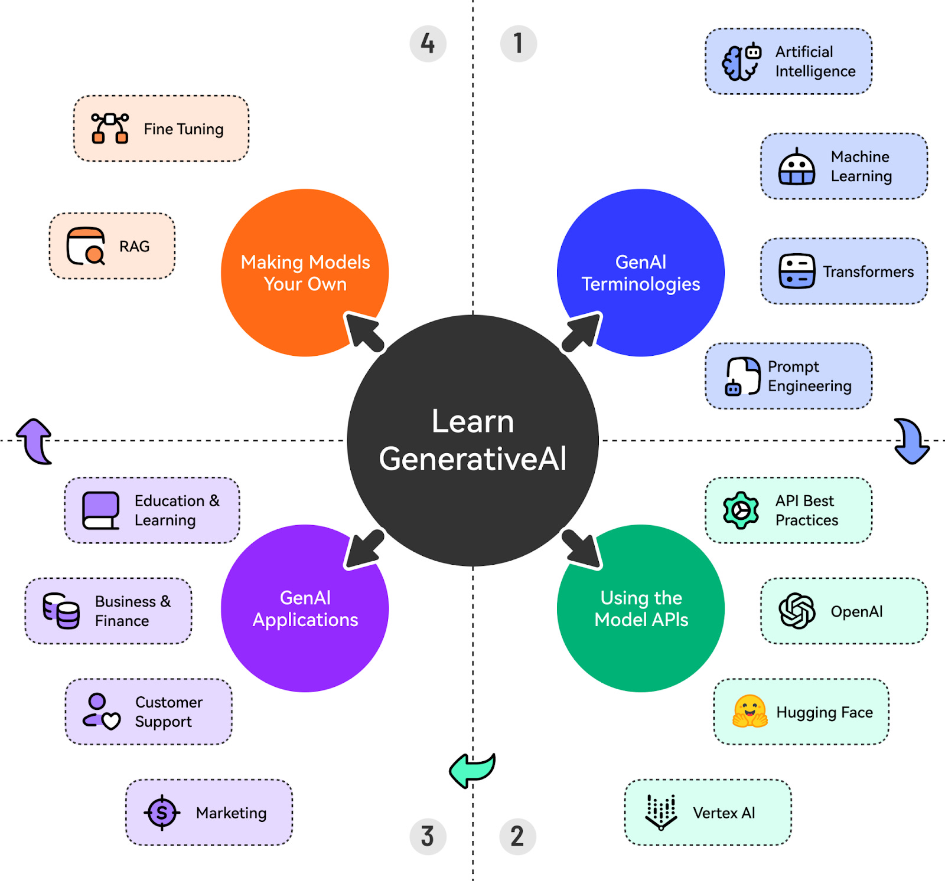
Course plan
What will we do?
Classic lectures with principles, architectures and methods description
Core papers overview
Training techniques with distributed approaches
Optimization approaches for efficient tuning and inference
Each field of study includes different paradigms to discuss
Some lectures will be online
Notes:
https://www.leewayhertz.com/current-state-of-generative-ai/#How-is-generative-AI-driving-value-across-major-industries

Slide 7
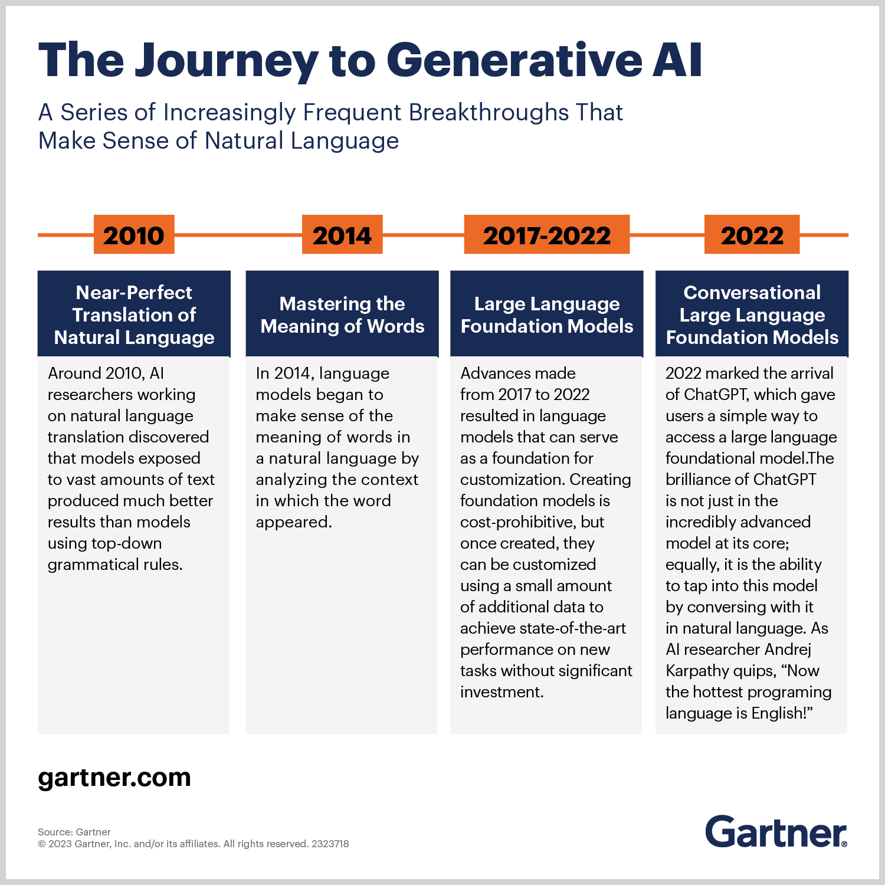

Slide 8
Historical view. AI, AGI, …

Slide 9

Artificial intelligence
“The appropriately programmed computer with the right inputs and outputs would thereby have a mind in exactly the same sense human beings have minds.”
John Searle
«Minds, brains, and programs» 1980.

Slide 10
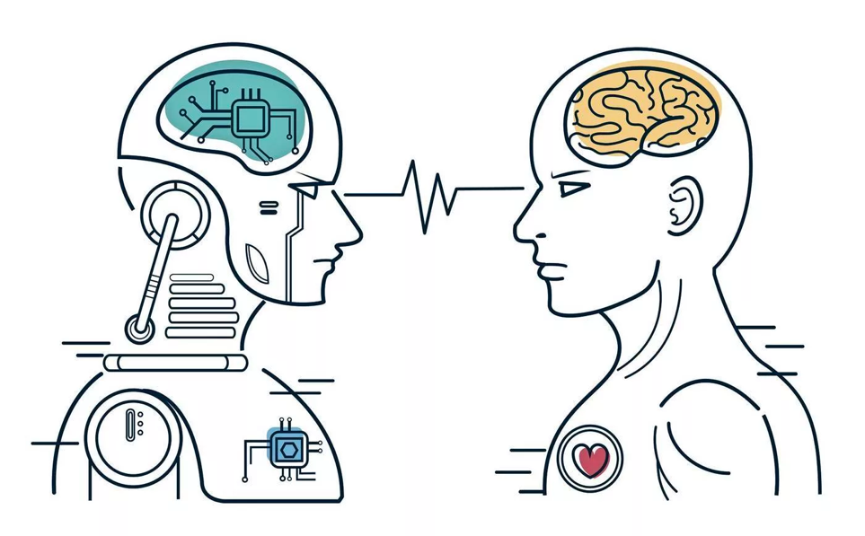
AI forms
Weak
Strong
One specific task
Trained on this task
No self-recognition/ self-correction
Can not work independently
Number of tasks
Easy to adapt, searching for new task settings, planning and reasoning ability
Self-recognition
Self-reflection
Thinking ability
”According to Strong AI, the correct simulation really is a mind. According to Weak AI, the correct simulation is a model of the mind.” J. Searle, "Chinese room argument", Scholarpedia, 4 (8): 3100, 2009.

Slide 11


Turing test: imitation game
«A person interacts with one computer and one person. Based on the answers to questions, he must determine who he is talking to: a person or a computer program. The task of the computer program is to mislead the person, forcing him to make the wrong choice»
Alan Turing, «Computing Machinery and Intelligence»
1950
Turing Test
1966
ELIZA
1972
PARRY
…
2023
GPT4

Slide 12

Generative AI. Fields of study
Large language models
Multimodal perception
Multimedia generation
Attention mechanism
Tokenizers
Transformer architectures
Encoders and decoders
Types of modalities fusion
Encoders for modalities
Contrastive-like models
Visual language models
Transformer-based models
Diffusion-based models
Flow matching
Distributed training

Slide 13
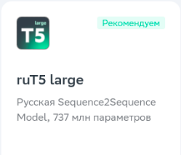
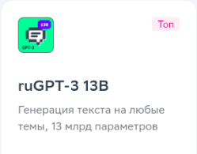
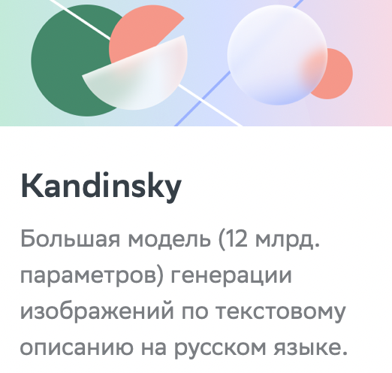
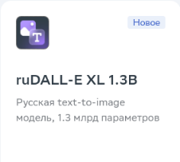


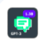
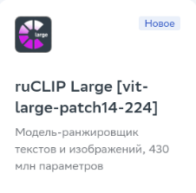
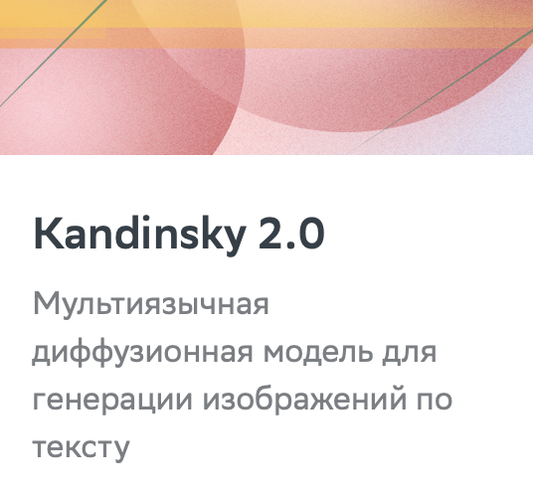


Experience of AIRI and Sber
2020–2021
2022
2023–2024
2 modalities
2 modalities
3+ modalities
Text + image
Text + image
Text + code
Text + audio
Text + image + audio + code + graph + video + event sequences
3+ модальностей
mGPT large
Мультиязычная генерация текста на любые темы, 760 млн параметров
Kandinsky 2.1 & 2.2
Мультиязычная диффузионная модель генерации изображений по тексту
Kandinsky 3.0
Мультиязычная диффузионная модель генерации изображений по тексту, улучшенная архитектура
RUDOLPH 2.7B
Мультимодальная архитектура для решения задач на стыке изображений и текстов
OmniFusion 1.0 & 1.1
Мультимодальная модель понимания изображений, аудио и видео
Мультимодальная архитектура для решения задач на стыке изображений и текстов

Slide 14







Weak AI model
Training
Problem solution
Text summarization
Single modality
AI model
Single task
Question answering
Face recognition

Slide 15
Large language models
02

Slide 16
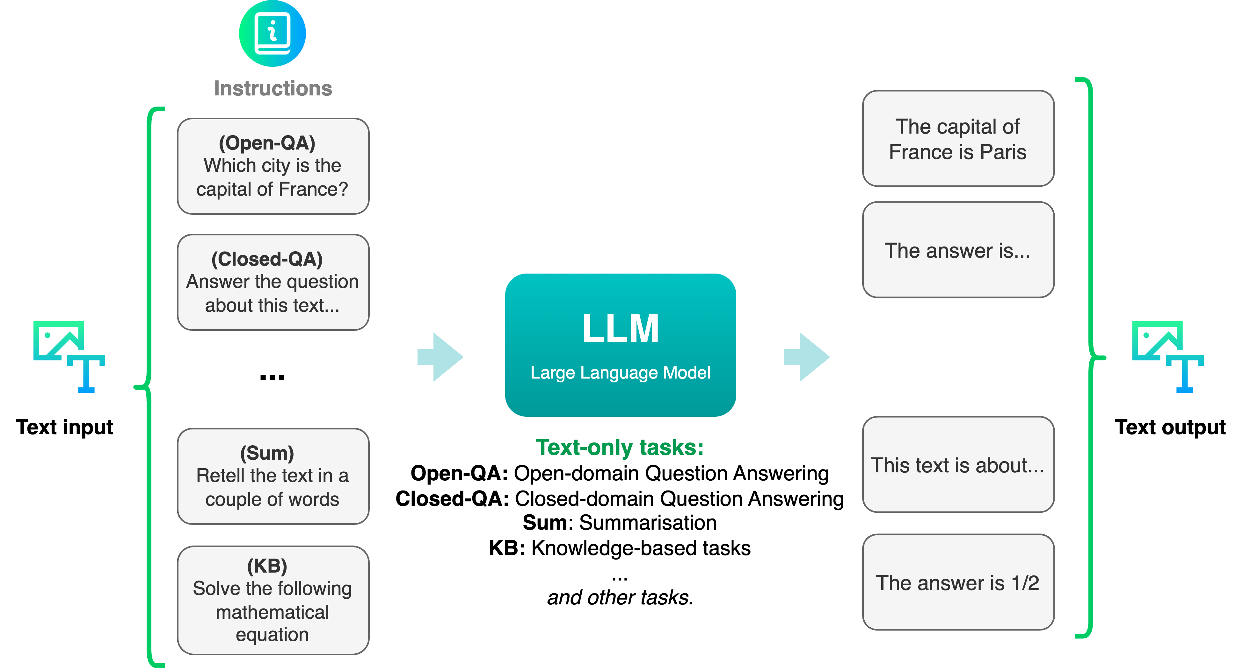
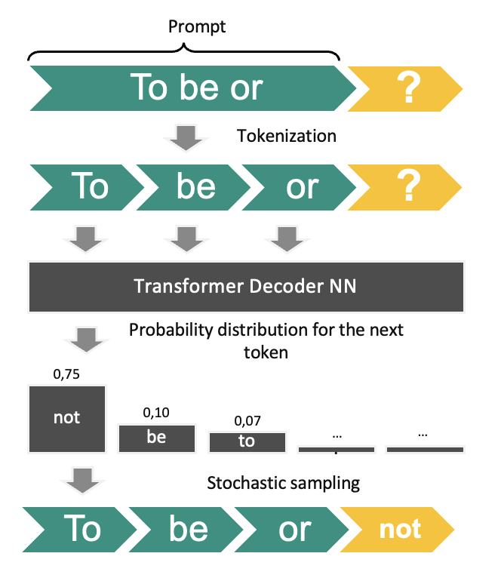

Rapid LLM development
Why LLMs always popular?
Text – basis of communication
Text – main source of the world knowledge
Chatbots primarily need text
LLMs (decoder-like)

Slide 17
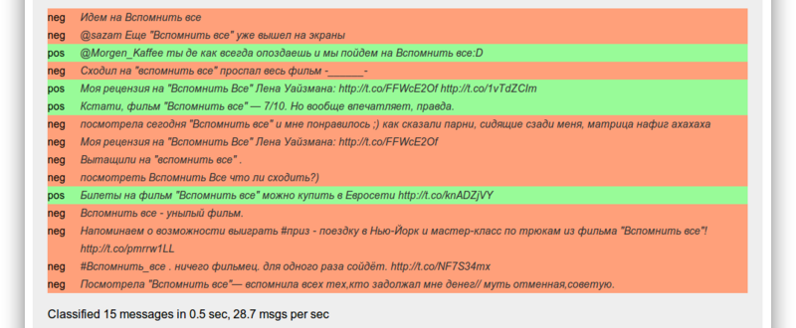
Text intent analysis

Slide 18
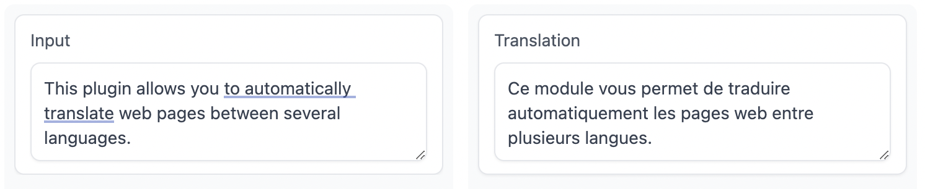
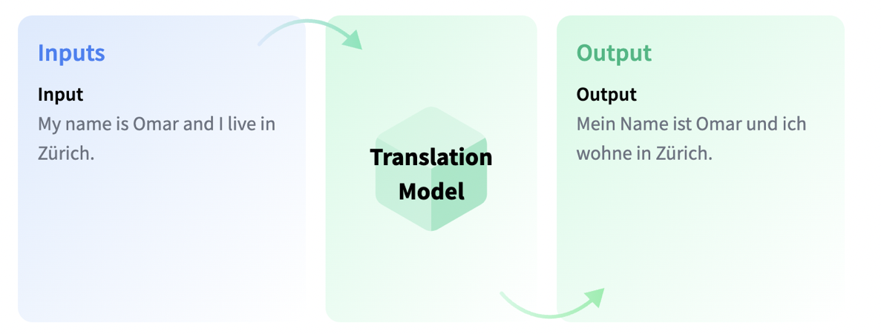
Machine translation

Slide 19
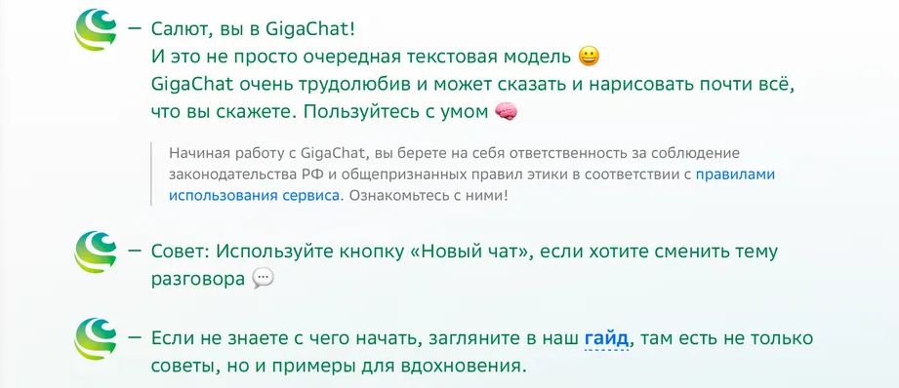
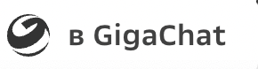


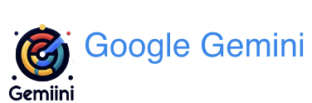
Chatbot assistant

Slide 20
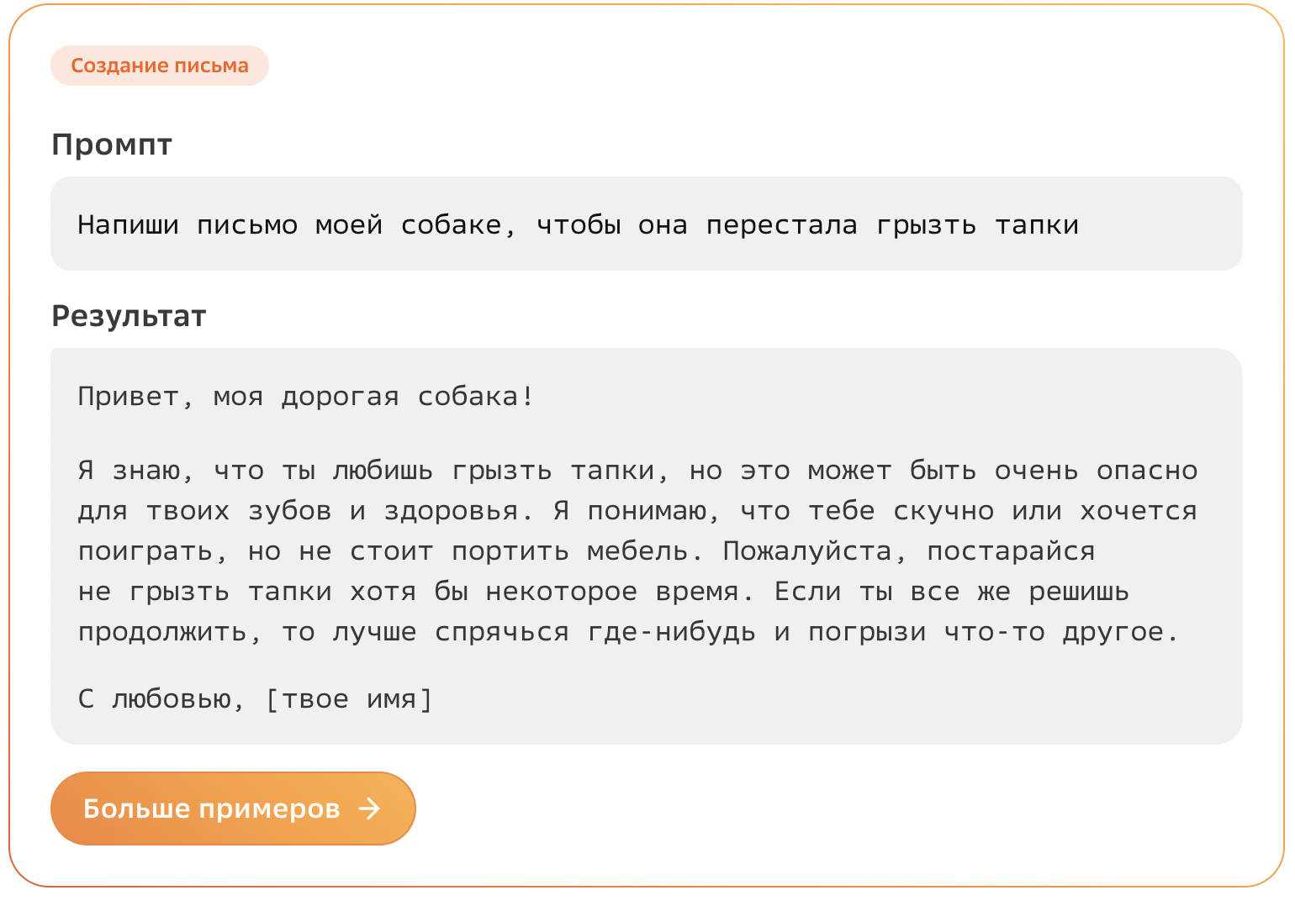
Chatbot assistant

Slide 21
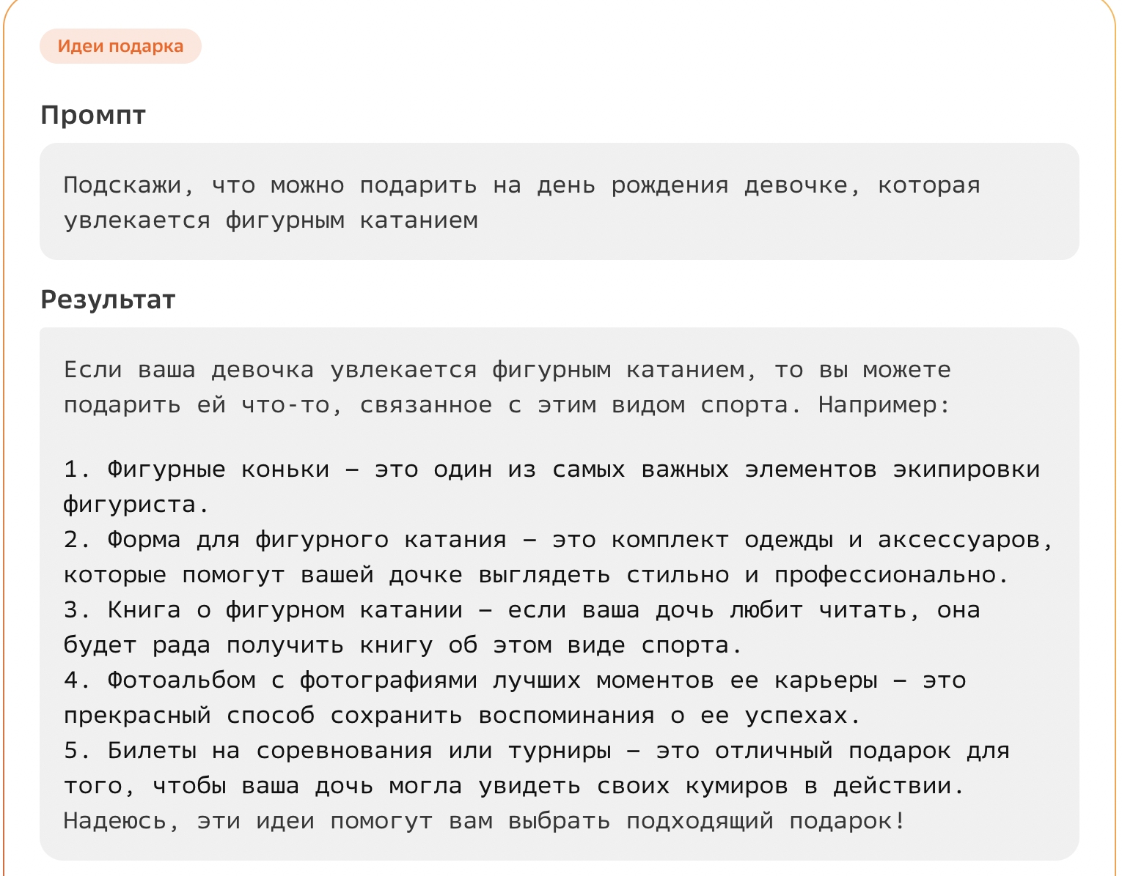
Chatbot assistant

Slide 22
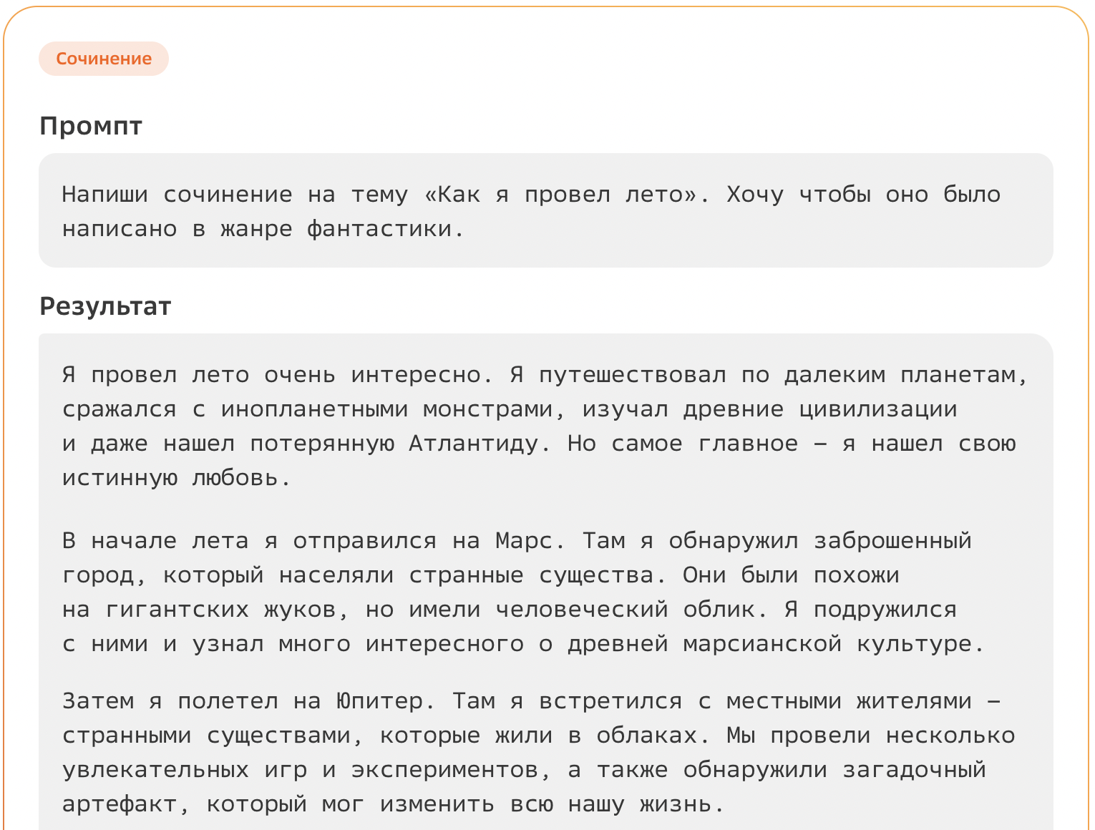
Chatbot assistant

Slide 23
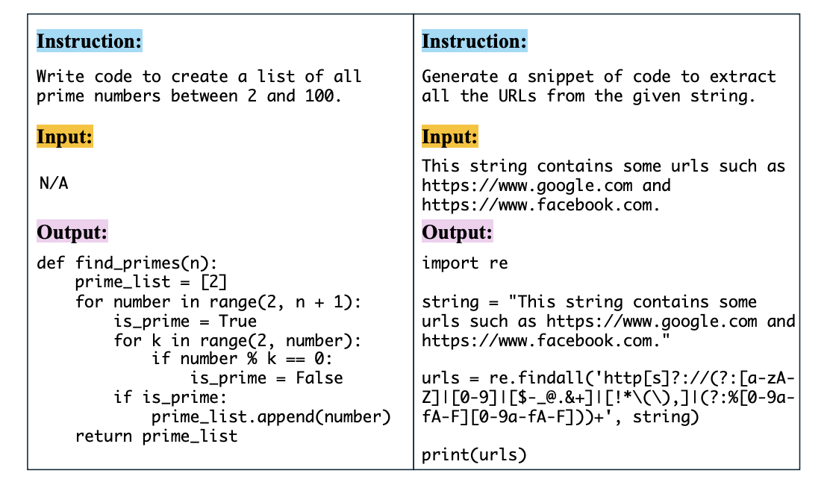
Chatbot assistant

Slide 24


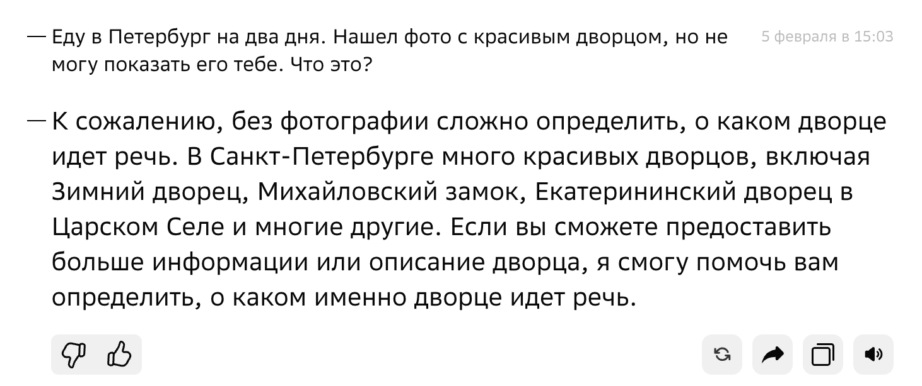

However text is not enough

Slide 25
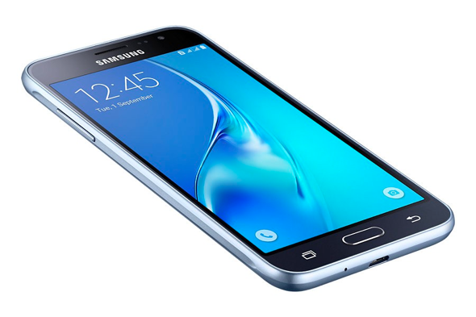
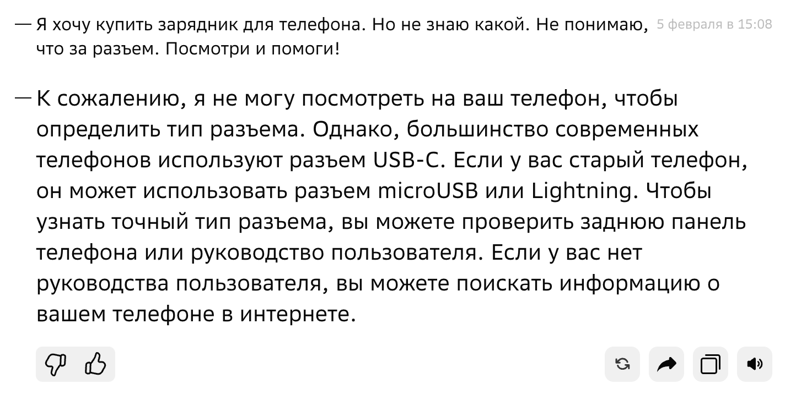
However text is not enough

Slide 26
Multimodal perception
03

Slide 27
Multimodal AI
Multimodal AI is a computational field focusing on understanding and leveraging multiple modalities
A modality refers to a way in which a natural phenomenon is perceived or expressed

Slide 28
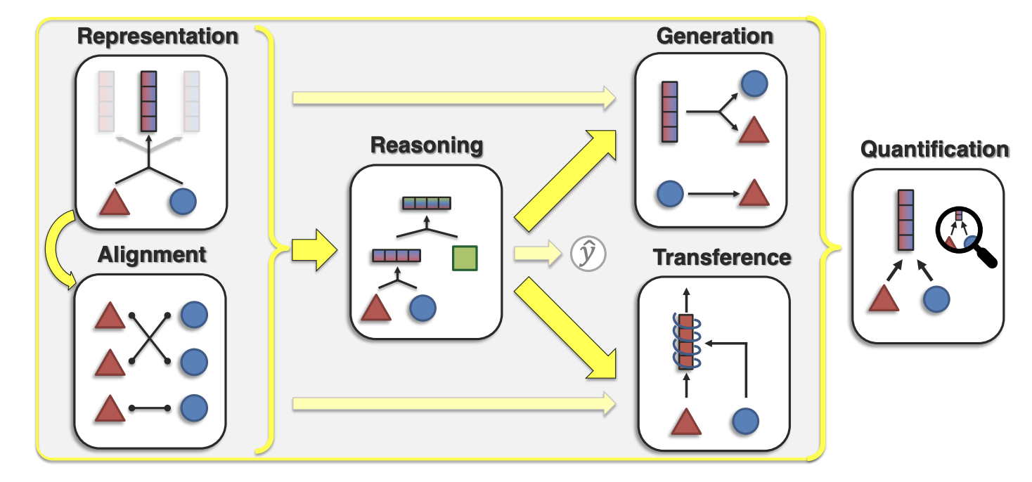
Core research challenges
Representation — represent and summarize multimodal data to reflect the heterogeneity and interconnections between individual modality elements
Alignment — identify the connections and interactions across all elements
Reasoning — compose knowledge from multimodal evidence usually through multiple inferential steps for a task
Generation — learning a generative process to produce raw modalities that reflect cross-modal interactions, structure, and coherence
Transference — transfer knowledge between modalities and their representations
Quantification — empirical and theoretical studies to better understand the multimodal learning process
Foundations & Trends in Multimodal Machine Learning: Principles, Challenges, and Open Questions https://arxiv.org/abs/2209.03430
Notes:
Representation (§3): Can we learn representations that reflect heterogeneity and intercon- nections between modality elements? We will cover approaches for (1) representation fusion: integrating information from two or more modalities to capture cross-modal interactions, (2) representation coordination: interchanging cross-modal information with the goal of keeping the same number of representations but improving multimodal contextualization, and (3) repre- sentation fission: creating a larger set of disjoint representations that reflects knowledge about internal structure such as data clustering or factorization.
Alignment (§4): How can we identify the connections and interactions between modality elements? Alignment is challenging since it may depend on long-range dependencies, involves ambiguous segmentation (e.g., words or utterances), and could be either one-to-one, many- to-many, or not exist at all. We cover (1) discrete alignment: identifying connections between discrete elements across modalities, (2) continuous alignment: modeling alignment between con- tinuous modality signals with ambiguous segmentation, and (3) contextualized representations: learning better representations by capturing cross-modal interactions between elements.
(3) Reasoning (§5) is defined as composing knowledge, usually through multiple inferential steps, that exploits the problem structure for a specific task. Reasoning involves (1) modeling the structure over which composition occurs, (2) the intermediate concepts in the composition process, (3) understanding the inference paradigm of more abstract concepts, and (4) leveraging large-scale external knowledge in the study of structure, concepts, and inference.
(4) Generation (§6) involves learning a generative process to produce raw modalities. We cat- egorize its subchallenges into (1) summarization: summarizing multimodal data to reduce information content while highlighting the most salient parts of the input, (2) translation: trans- lating from one modality to another and keeping information content while being consistent with cross-modal connections, and (3) creation: simultaneously generating multiple modalities to increase information content while maintaining coherence within and across modalities.
(5) Transference (§7) aims to transfer knowledge between modalities, usually to help the target modality, which may be noisy or with limited resources. Transference is exemplified by (1) cross-modal transfer: adapting models to tasks involving the primary modality, (2) co-learning: transferring information from secondary to primary modalities by sharing representation spaces between both modalities, and (3) model induction: keeping individual unimodal models separate but transferring information across these models.
(6) Quantification (§8): The sixth and final challenge involves empirical and theoretical studies to better understand (1) the dimensions of heterogeneity in multimodal datasets and how they subsequently influence modeling and learning, (2) the presence and type of modality connections and interactions in multimodal datasets and captured by trained models, and (3) the learning and optimization challenges involved with heterogeneous data.

Slide 29
Key principles
Heterogeneity
Connection
Interaction

Slide 30
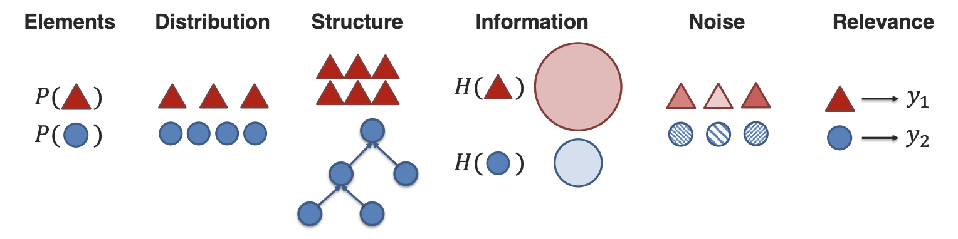
Modalities heterogeneity
Notes:
(1) Element representation: Each modality is typically comprised of a set of elements - the most
basic unit of data which cannot (or rather, the user chooses to not) be broken down into further units [26, 147]. For example, typed text is recorded via a set of characters, videos are recorded via a set of frames, and graphs are recorded via a set of nodes and edges. What are the basic elements present in each modality, and how can we represent them? Formally, this dimensions measures heterogeneity in the sample space or representation space of modality elements.
(2) Distribution refers to the frequency and likelihood of elements in modalities. Elements typically follow a unique distribution, with words in a linguistic corpus following Zipf’s Law as a classic example. Distribution heterogeneity then refers to the differences in frequencies and likelihoods of elements, such as different frequencies in recorded signals and the density of elements.
(3) Structure: Natural data exhibits structure in the way individual elements are composed to form entire modalities [38]. For example, images exhibit spatial structure across individual object elements, language is hierarchically composed of individual words, and signals exhibit temporal structure across time. Structure heterogeneity refers to differences in this underlying structure.
(4) Information measures the total information content present in each modality. Subsequently, information heterogeneity measures the differences in information content across modalities, which could be formally measured by information theoretic metrics [227].
(6) Relevance: Finally, each modality shows different relevance toward specific tasks and contexts - certain modalities may be more useful for certain tasks than others [78]. Task relevance describes how modalities can be used for inference, while context relevance describes how modalities are contextualized with other modalities.

Slide 31
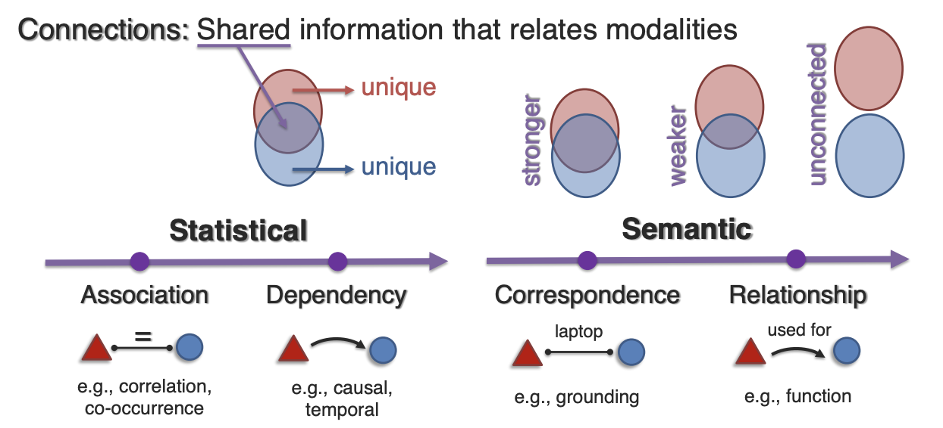
Modalities connection
Notes:
Statistical association exists when the values of one variable relate to the values of another. For example, two elements may co-occur with each other, resulting in a higher frequency of both occurring at the same time. Statistically, this could lead to correlation - the degree in which elements are linearly related, or other non-linear associations. From a data-driven perspective, discovering which elements are associated with each other is important for modeling the joint distributions across modalities during multimodal representation and alignment [257].
(2) Statistical dependence goes deeper than association and requires an understanding of the exact type of statistical dependency between two elements. For example, is there a causal dependency from one element to another, or an underlying confounder causing both elements to be present at the same time? Other forms of dependencies could be spatial or temporal: one element occurring above the other, or after the other. Typically, while statistical association can be estimated purely from data, understanding the nature of statistical dependence requires some knowledge of the elements and their underlying relationships [188, 267].
(3) Semantic correspondence can be seen as the problem of ascertaining which elements in one modality share the same semantic meaning as elements in another modality [192]. Identify- ing correspondences is fundamental in many problems related to language grounding [46], translation and retrieval [203], and cross-modal alignment [248].
(4) Semantic relations: Finally, semantic relations generalize semantic correspondences: instead of modality elements sharing the same exact meaning, semantic relations includes an attribute describing the exact nature of the relationship between two modality elements, such as semantic, logical, causal, or functional relations. Identifying these semantically related connections is important for higher-order reasoning [26, 172].

Slide 32
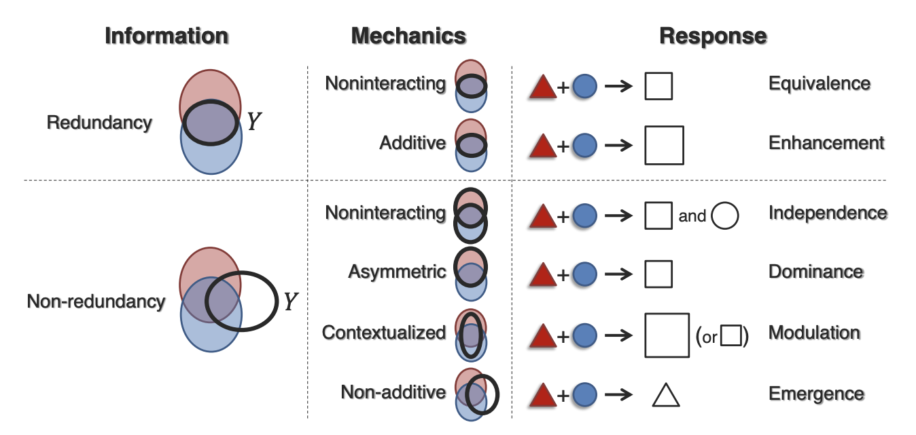
Modalities interaction
Notes:
Interaction information investigates the type of connected information that is involved in
an interaction. When an interaction involves shared information common to both modalities, the interaction is redundant, while a non-redundant interaction is one that does not solely rely on shared information, and instead relies on different ratios of shared, unique, or possibly even synergistic information [290].
(2) Interaction mechanics are the functional operators involved when integrating modality elements for task inference. For example, interactions can be expressed as statistically additive, non-additive, and non-linear forms [117], as well as from a semantic perspective where two elements interact through a logical, causal, or temporal operation [268].
(3) Interaction response studies how the inferred response changes in the presence of multiple modalities. For example, through sub-dividing redundant interactions, we can say that two modalities create an equivalence response if the multimodal response is the same as responses from either modality, or enhancement if the multimodal response displays higher confidence. On the other hand, non-redundant interactions such as modulation or emergence happen when there exist different multimodal versus unimodal responses [197].

Slide 33
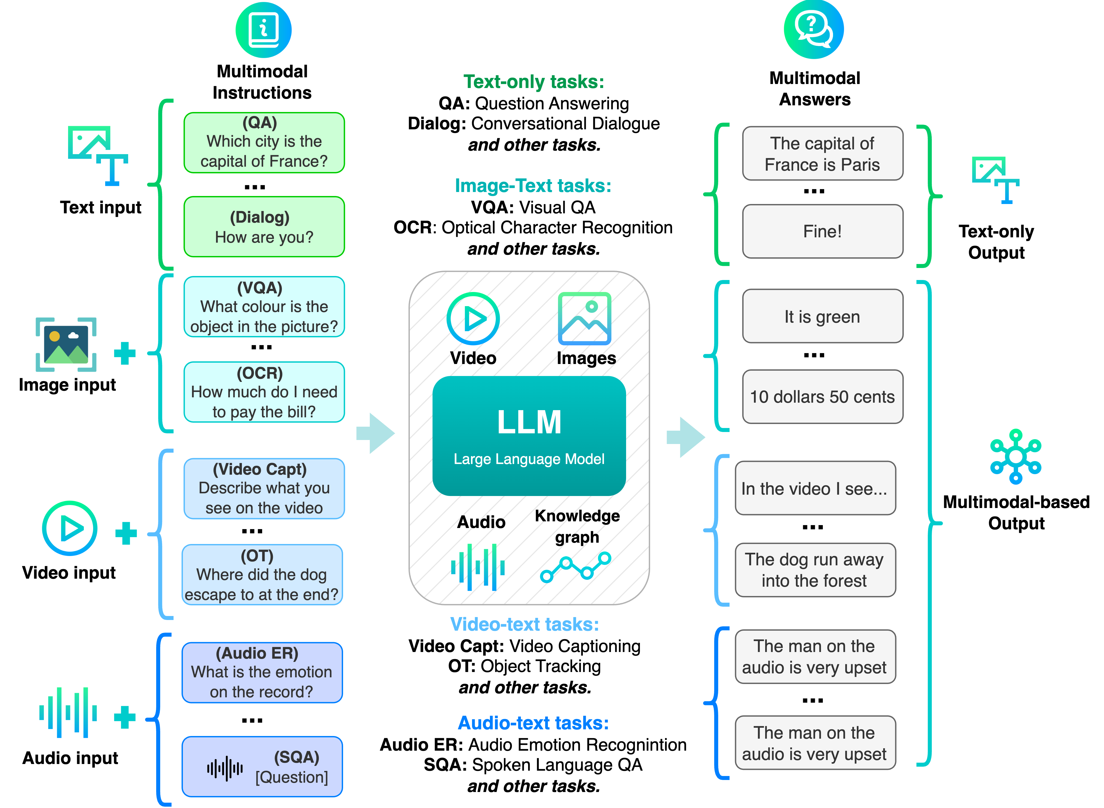
LLM → Multimodal LLM
Why do we need something more than text?
People are used to communicate using more than just text
To design a high-quality AI assistant, you need to train it to use more than just text
Text + images + sound + video + ... — this is the perfect NATURAL scenario for interaction

Slide 34
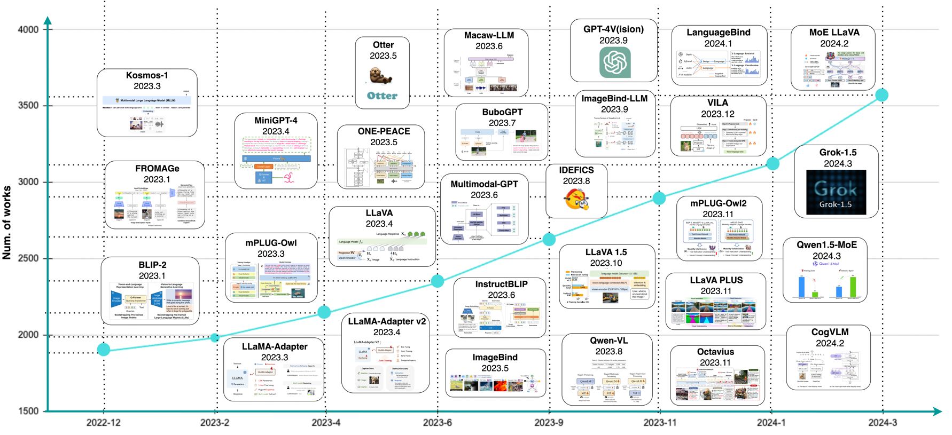

Slide 35
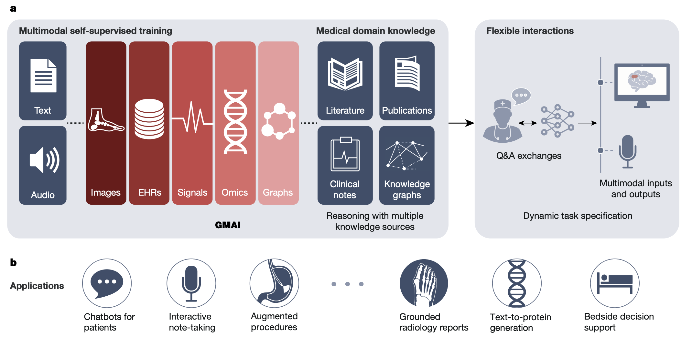
Just a case

Slide 36
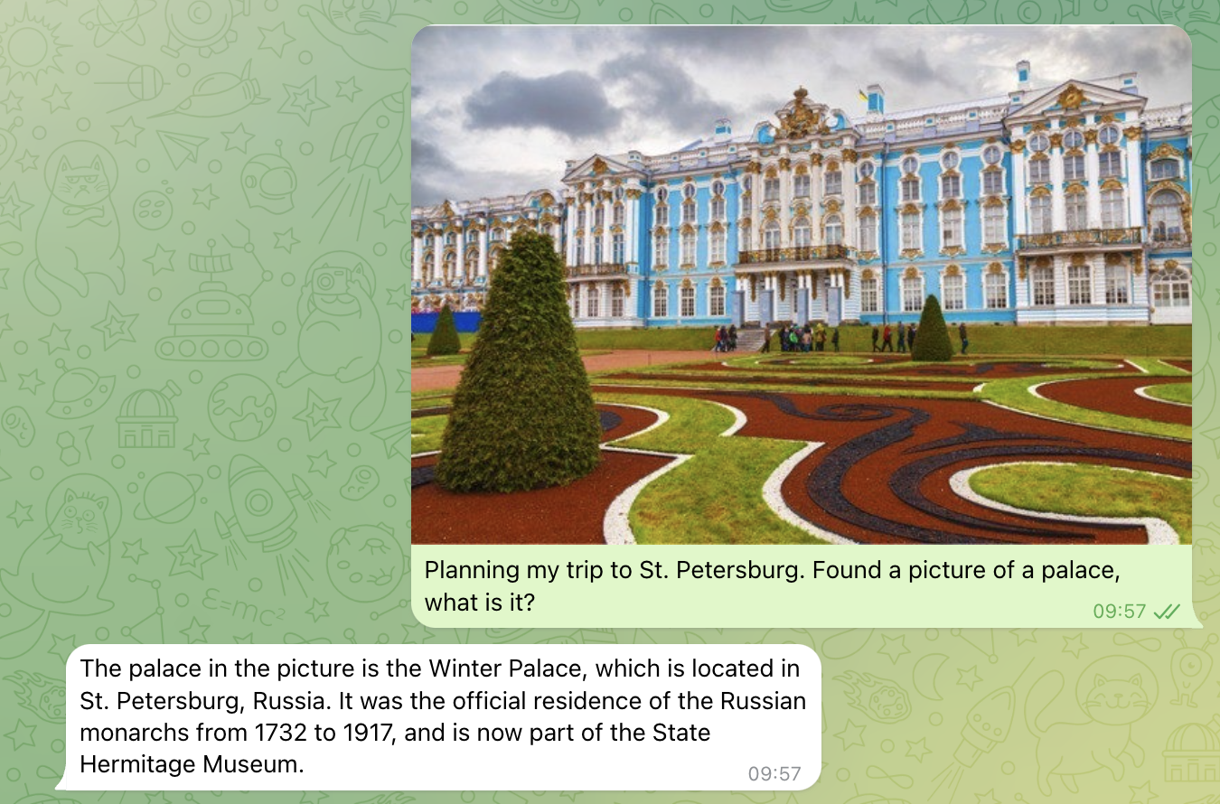
One more try…

Slide 37
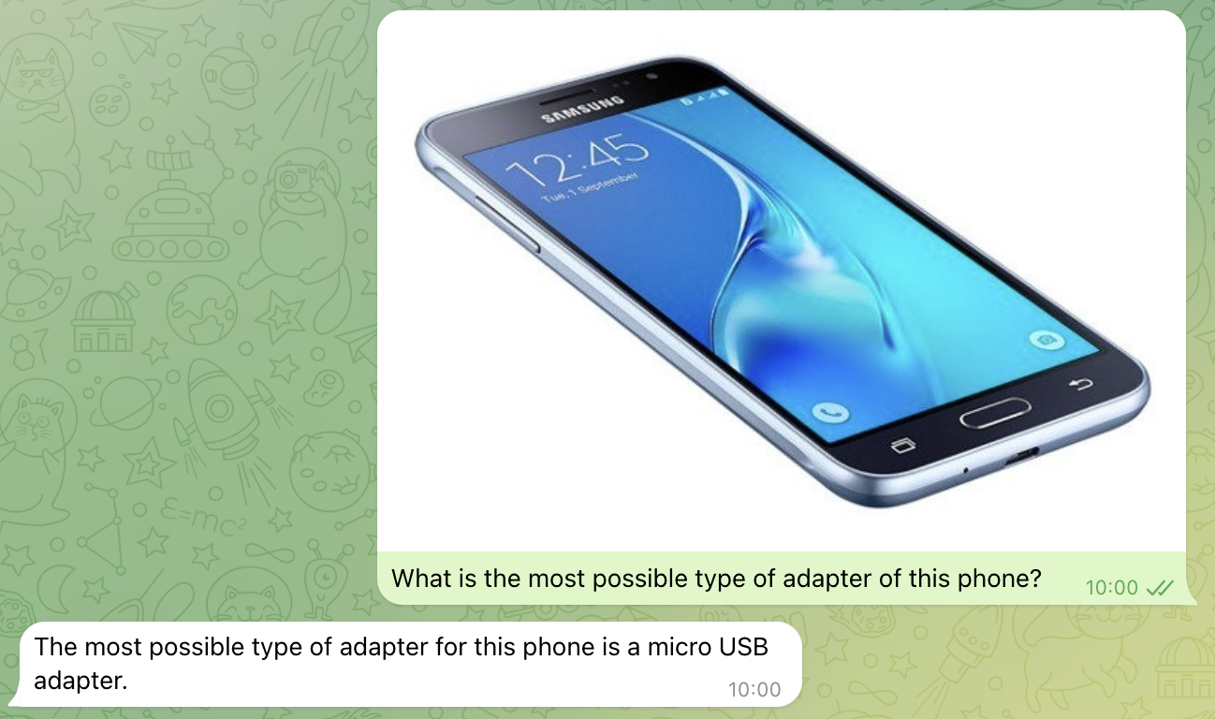
And the other one…

Slide 38
Multimedia synthesis
04

Slide 39
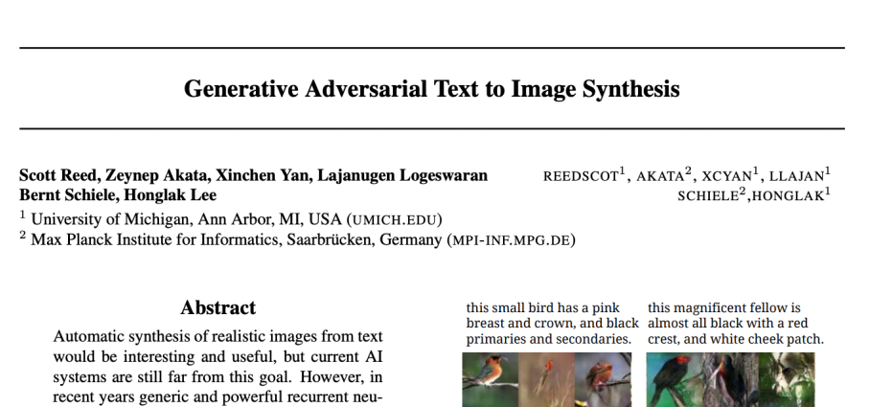
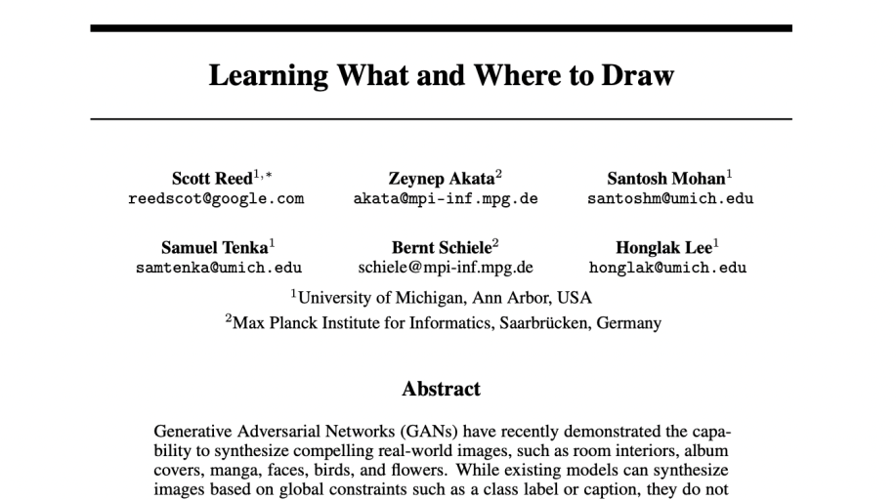
Brief history of generative models
Classic computer vision tasks such as classification, segmentation, and detection were solved in a single modality – the standard approach
The emergence of GAN in 2014 was a breakthrough in the development of generative models
The first mention of image generation from textual descriptions was made at ICML 2016 and NeurIPS 2016 (S. Reed et al.)
Since 2017, no ML/DL/CV conference A/A* passes without publications on the topic of image synthesis from textual descriptions

Slide 40
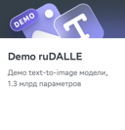
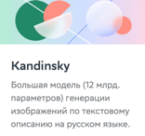
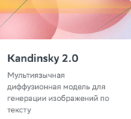
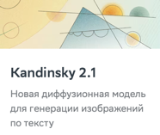
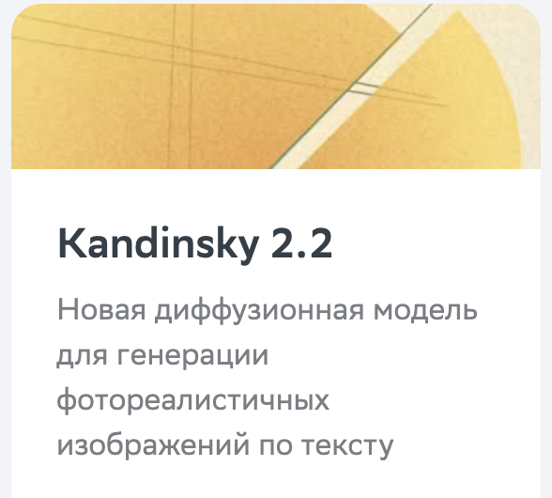

Text-to-image models by AIRI and Sber
Nov. 2,
2021
June 14, 2022
Nov. 23, 2022
Apr. 4,
2023
July 12, 2023
November 22, 2023
Malevich
Kandinsky 1.0
Kandinsky 2.0
Kandinsky 2.1
Kandinsky 2.2
Kandinsky 3.0
1.3 В
12.0 В
2.0 В
3.3 В
4.8 В
11.9 В
Autoregressive image generation from Russian text
Autoregressive image generation from Russian text
Latent diffusion model for generating images from text in 101 languages
Latent diffusion model for generating images from text
Latent diffusion model for generating photorealistic images from text
New generation latent diffusion model for generating photorealistic images from text
9 million
GPU-minutes
46 million
GPU-minutes
18 million
GPU-minutes
5 million
GPU-minutes
2 million
GPU-minutes

Slide 41
Video generation
A new field with no default training pipelines
High quality open source is insufficient
High computational complexity
 | Large Language Models (LLM) | Video Generation Models (VGM, VPT, GWM)
Start year | 2017 | 2023
Default architectures with training code and scaling laws | GPT, BERT, T5, etc. | Currently, DiT
Open Source | LLaMA (Meta), Mistral (Mistral AI), Gemma (Google, DeepMind), Grok (X.ai), etc. | Open-Sora, Open-Sora-Plan, CogVideoX (Zhipu AI)
Context length | 128k | 864k (10s, 720p resolution)

Slide 42
Video generation models race
Company | Model | Country | Status | Date | GPU resources needed (est.) | Datasets (est.) | Architecture | Output
Open AI | Sora | USA | Announce | 15.02.2024 | Cluster power ~2 000 — 10 000 H100 | 100М pairs «text-video», «text-image», images and videos w/o description | DiT | 1080p video up to 60s
ShengShu | Vidu | China | Announce | 27.04.2024 |  |  | U-ViT | 1080p video up to 16s
DeepMind, Google | Veo | USA | Announce | 14.05.2024 |  |  | DiT | 1080p video up to 60s
Luma Labs | Dream Machine | USA | Open demo | 12.06.2024 |  |  | DiT (?) | 1080p video up to 120s
Runway AI | Gen-3 | USA | Open demo | 17.06.2024 |  |  | DiT (?) | 1080p video up to 10s
Kuaishou Technology | Kling | China | Open demo | 24.07.2024 |  |  | DiT (?) | 1080p video up to 120s

Slide 43
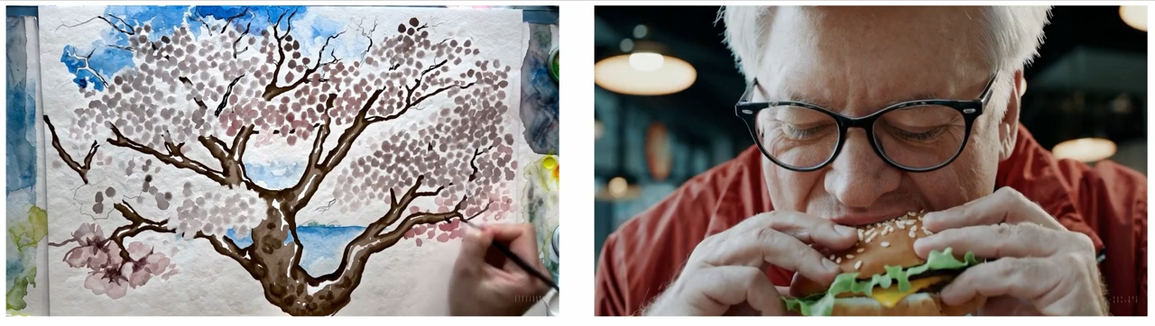


Video generation models race
Prompt: Reflections in the window of a train traveling through the Tokyo suburbs.

Slide 44

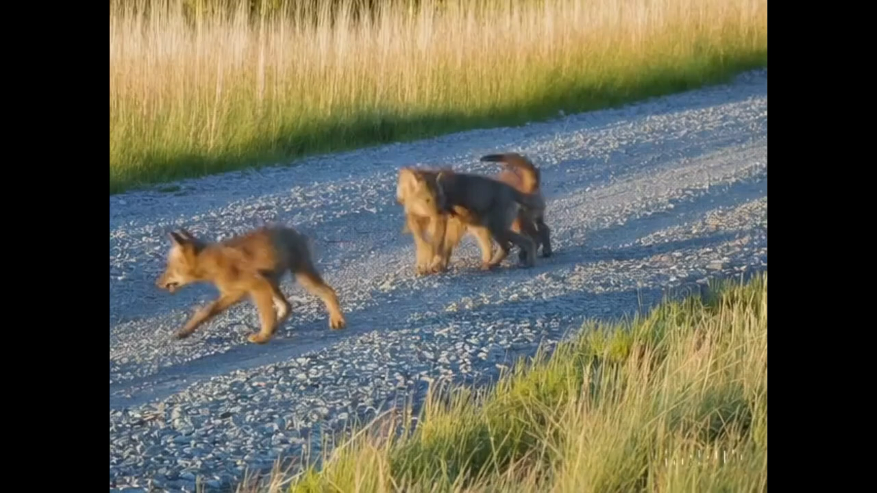

Far from perfect
We're sharing our research progress early to start working with and getting feedback from people outside of OpenAl and to give the public a sense of what Al capabilities are on the horizon.
Prompt: Five gray wolf pups frolicking and chasing each other around a remote gravel road, surrounded by grass. The pups run and leap, chasing each other, and nipping at each other, playing. Weakness: Animals or people can spontaneously appear, especially in scenes containing many entities.
https://openai.com/index/sora/
https://openai.com/index/video-generation-models-as-world-simulators/

Slide 45
Course outcomes
Understand key principles of multimodal research
Dive into several fields of study
Get expertise in training strategies
Complete a home assignment project
Notes:
https://www.leewayhertz.com/current-state-of-generative-ai/#How-is-generative-AI-driving-value-across-major-industries

Slide 46
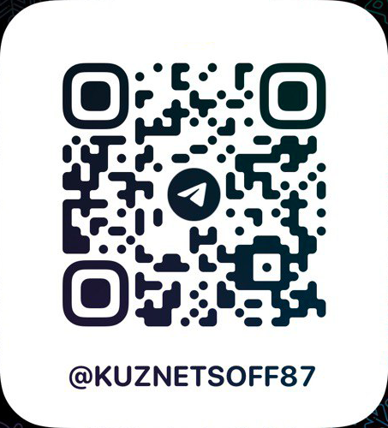
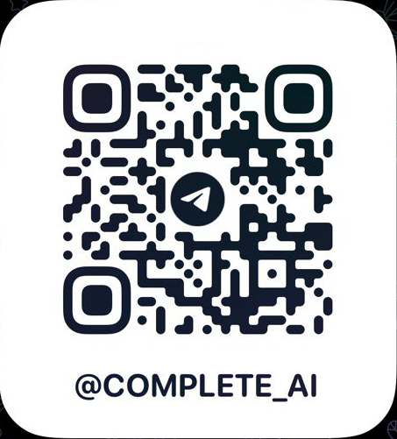
Contacts
Contacts
PhD, Head of FusionBrain Lab, AIRI Executive director on data science, Sber AI kuznetsov@airi.net

